Slide 1
12. NEO Persistable Classes (NPC) Platform 2.1: Preview
NEO Blockchain Quick Start Guide for .NET Developers
Michael Herman
https://github.com/mwherman2000/neo-dotnetquickstart
https://github.com/mwherman2000/neo-csharpcoe
https://github.com/mwherman2000/neo-persistableclasses
neotoronto@outlook.com

Slide 2
Purpose, Goals, Principles and Drivers
Purpose
An overview of the architecture of the NEO Persistable Classes (NPC) Platform 2.1
Live demonstration of building a C#.NPC smart contract with NPC Compiler 2.1
NPC workflows and NPC programming model
Show the output of the NPC Profiler execution cost analysis (built into the NEO Debugger)
Goals, Non-Goals and Assumptions
Level of detail: Awareness – not education or training
Principles
Provide reliable information: timely, accurate, visual, and complete
Use as little time of your time as possible
Drivers
Need in the NEO .NET developer community to have a concise and easy-to-follow documented approach that enables enterprise developers to get up to speed developing NEO smart contracts in as short a time as possible
Tools, Reusable Code, Documentation, Best Practices, Training

Slide 3
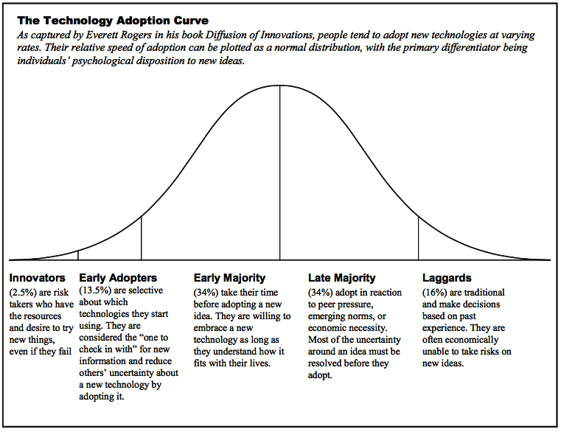
Audience
Target Audience
and
Knowledge Transfer Goals
Wisdom
Understanding
Knowledge
Awareness

Slide 4
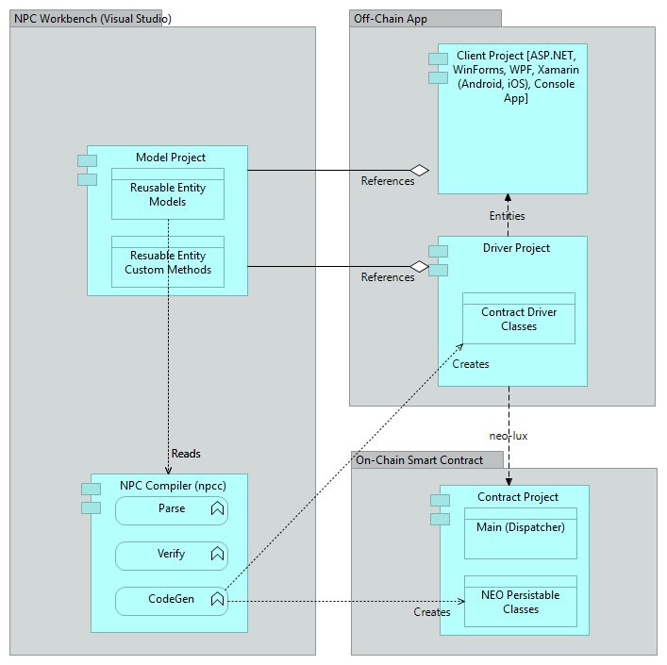













Architecture
NEO Persistable Classes (NPC) Platform 2.1 Architecture

Slide 5
Demo
Meetup Attendee Sign-in Scenario: Smart Contract v0.1

Slide 6
Resources
Webcasts
NEO Persistable Classes (NPC) e-dApp Smart Contract Platform 2.0: Deep Dive (100 minutes) https://www.youtube.com/watch?v=Nj4-m2o94VE
Activity 11. Quick Cycle Edit-Compile-Debugging of C#.NEO Smart Contracts https://www.youtube.com/watch?v=cXBzuuve36Q
Projects
NEO Blockchain C# Developers Center of Excellence (neo-csharpcoe) https://github.com/mwherman2000/neo-csharpcoe
NEO Blockchain Quick Start Guide for .NET Developers https://github.com/mwherman2000/neo-dotnetquickstart/blob/master/README.md
NEO Persistable Classes (NPC) Platform 2.0 - An Efficient Entity-based Platform for enterprise distributed application development using .NET/C#, C#.NEO and the NEO Blockchain https://github.com/mwherman2000/neo-persistableclasses/blob/master/README.md
NEO Persistable Classes (NPC) Compiler 2.1 (npcc) - Compiler for the NEO Persistable Classes (NPC) Platform 2.1 https://github.com/mwherman2000/neo-npcc2/blob/master/README.md

Slide 7
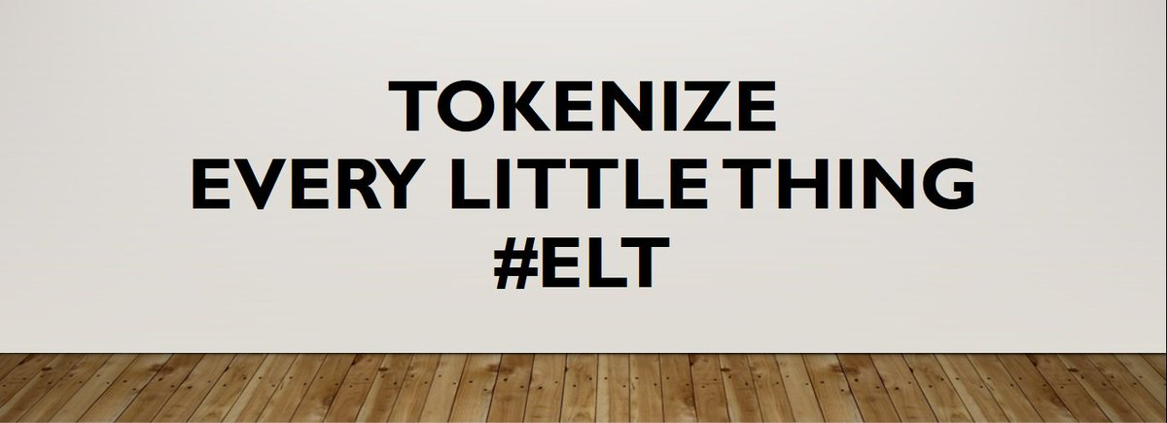
Questions?
https://hyperonomy.com/2018/01/24/tokenization-of-every-little-thing-elt/
Discord: https://discord.gg/gqCYeup
LinkedIn: https://www.linkedin.com/in/mwherman/
neotoronto@outlook.com

